Slide 1
Software Design And Architecture (SE:2002)
Entity Control and Boundary Classes

Slide 2
ECB(Robustness Analysis):
The Robustness Analysis is a practice that originated with Ivar Jacobson’s Objectory Method. (also called Jacobson’s diagram).
This involves analyzing the narrative text of use cases, identifying the first-guess set of objects that will participate in those use cases, and classifying these objects based on the roles they play.
Robustness analysis helps you to bridge the gap from Use Cases and Domain Classes.
It is a use-case driven object-oriented software design.

Slide 3
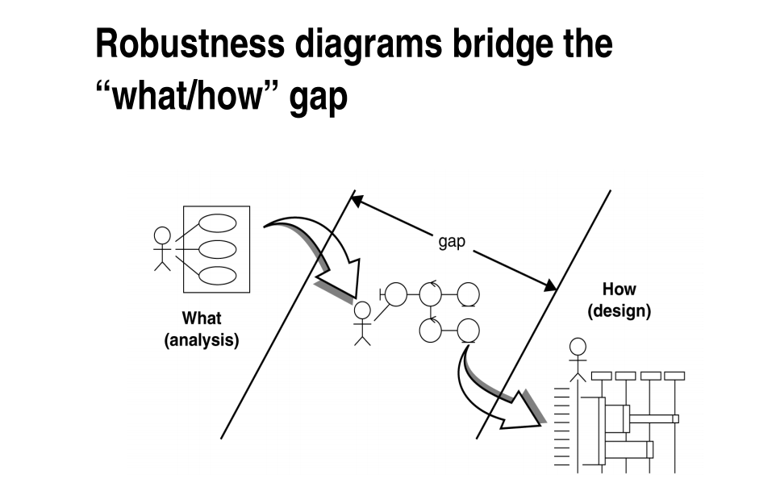

Slide 4
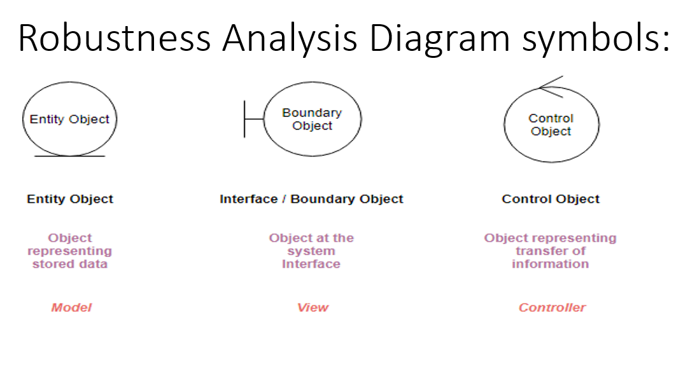
ECB partitions the system into three types of classes:
entities,
controls,
and boundaries.
entity, control, and boundary are official UML class stereotypes. UML has some special icons to represent them.

Slide 5
Boundary object (or interface object) is what actors use in communicating with the system.
Entity object Entities are objects representing system data: Customer, Product, Transaction, Cart, etc.
Control objects (also known as controllers in MVC), which serve as the “glue” between boundary objects and entity objects.

Slide 6
Several Types of Boundary Classes
User interface classes –
Classes that facilitate communication with human users of the system
Menus, forms, etc.
System interface classes :
Classes which facilitate communications with other systems.
These boundary classes are responsible for managing the dialogue with the external system, like getting data from an existing database system or flat file.
Provides an interface to that system for this system.
Device Interface Classes
Provide an interface to devices which detect external events – like a sensor or …
One boundary class per use case/actor pair

Slide 7
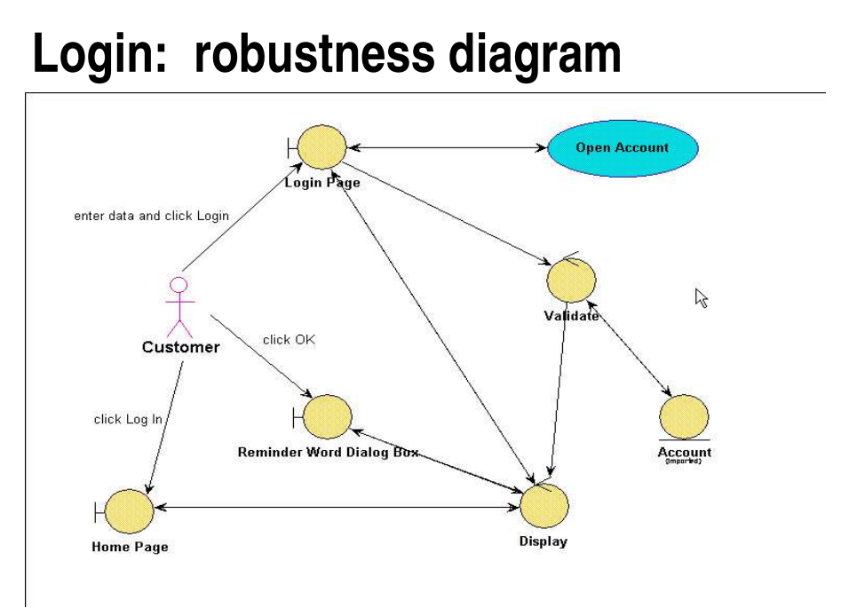
Robustness Analysis Diagram at a Glance:
Suppose we have the following simple use case description in textual format:
Login: use case text
Basic Course: The Customer enters his or her user ID and password, and then clicks the Log In button. The system validates the login information against the persistent Account data, and then returns the Customer to the Home Page and ask customer for reminder by displaying dialog box.

Slide 8
Edit Shopping Cart use case text:
Basic Course:
On the Shopping Cart Page, the Customer modifies the quantity of an Item in the Shopping Cart,
and then presses the Update button.
The system stores the new quantity, and then computes and displays the new cost for that Item.
Alternate Course:
If the Customer changes the quantity of the Item to 0, the system deletes that Item from the Shopping Cart.

Slide 9
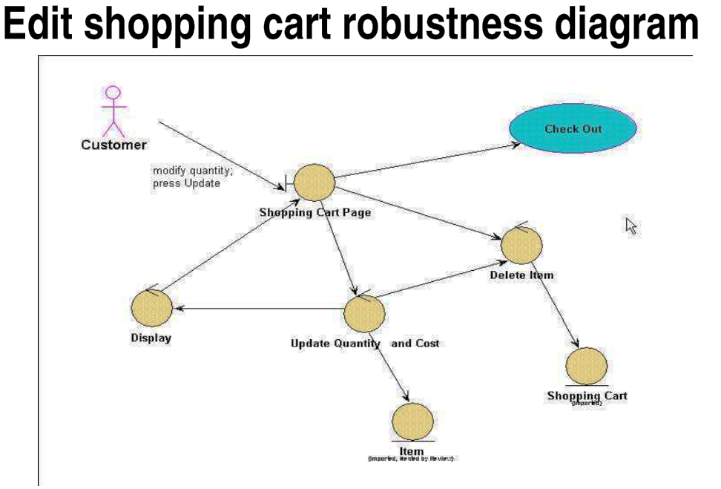

Slide 10
Robustness Diagram – 4 Connection Rules
Keep in mind that both boundary objects and entity objects are nouns and that controllers are verbs. Nouns can’t talk to other nouns, but verbs can talk to either nouns or verbs.
Here I listed the four basic connection rules which should always be mind:
Actors can only talk to boundary objects.
Boundary objects can only talk to controllers and actors.
Entity objects can only talk to controllers.
Controllers can talk to boundary objects and entity objects, and to other controllers, but not to actors.

Slide 11
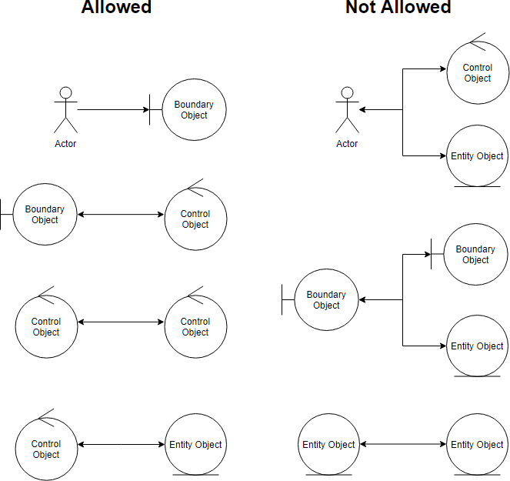
Robustness Analysis Diagram connection rules:

Slide 12
ECB:
ECB classes are first identified when use-cases are analyzed:
every use case is represented as a control class;
every different relation between a use-case and an actor is represented as a boundary class;
entities are derived from the use-case narrative.

Slide 13
Five Steps for Creating Robustness Analysis:
You perform robustness analysis for a use case by walking through the use case text.
One sentence at a time, and drawing the actors, the appropriate boundary, entity objects and controllers, and the connections among the various elements of the diagram.
You should be able to fit the basic course and all of the alternate courses on one diagram.
Anyone who reviews a robustness diagram should be able to read a course of action in the use case text, trace his finger along with the associations on the diagram, and see a clear match between text and picture.

Slide 14
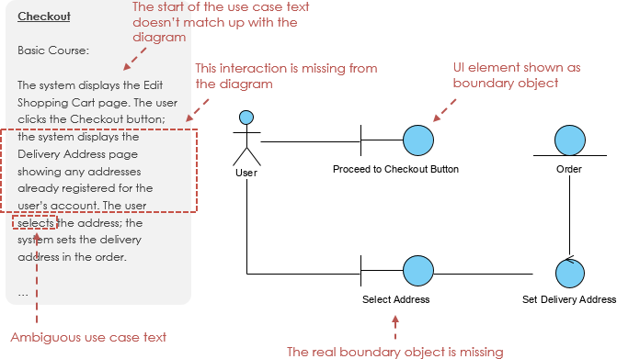

Slide 15
Use-Case: Place Order
Customer visits the Shopping cart page.
Customer clicks the Buy button.
The system displays the Order details form where the required data to complete the order (name, phone number, email, shipping and billing addresses, payment method) needs to be provided.
3.a. The system will retrieve information of the customer in order to populate a list of default values.
Customer fills in data and submits Order details form by clicking the Confirm button.
The system records the order.
5.a. It retrieves shopping cart elements to add them to the order.
6. The system displays the Order created page.

